Slide 1
BILLING SYSTEM (SUB SYSTEM OF RESTAURANT SYSTEM)
“Enterprise Systems Evaluation “
PREPARED BY:
Necha Sandra Pisngot (P.M.)
Janine Baroy (B.A.)
Kaecee Gayle Rivera (D.S.)
Therese Normielet Teleg (S.A.)
Joel Borasca (L.P.)

Slide 2
What the system does as a whole?
Issuing billing receipt.
Accepting any types of payments(Cash, credit card & GC)
Generating reports.
Can do changes in billing adjustment receipt in reservation.
Conserve more time in the transaction regarding in Senior Citizen and PWD discounts.
Backing up data and recover it.

Slide 3
2. Transactions covered, queries, reports, special technologies.
Transactions:
Types of payment
Cash:
-Acceptable
Credit:
-Encoding of information
-Verification of credit card
Gift Certificate and SC and PWD Discount:
-Encoding Information
-Verification of ID
-Registration
Generating of reports of every transactions
Backing up and recovery of data in the database

Slide 4
Reports:
Sending reports to the Accounting and HR as a form of communication or reporting of billing transactions.
Special Technology:
Registration and verification of Gift Certificate and SC and PWD customers.
3. Major difference from other similar systems.
The major difference of this billing system to the other system is the system has a unique feature that can register and verify the Gift Certificate and the ID’s of the SC and PWD customers.

Slide 5
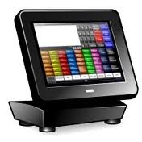
4. INTEGRATION WITH THE OTHER SUBSYSTEMS
Ordering System
Orders of the customers will send to the Kitchen and it will send it to the POS.
POS
Billing System
Reservation System
POS is connected to the billing for the transaction and payment.
Reservation personnel sends report to billing personnel for the details of the reservation and payments.
Accounting System
HR
Billing reports can view and send to the accounting for the checking and monitoring the transactions and sales.
Billing reports can view and send to the HR.

Slide 6
5. SOLUTION ARCHITECTURE
Org. Database
This architectural overview provides a high-level view of Billing System, support for Copy Server functionaly and thier interaction with other external systems.
Account Database
Billing Database
Secure Copy SERVER
BILLING SYSTEM
Transaction
• Registering of SC & PWD
Types of Payments
• Cash
• Credit
• SC/PWD
Back-up & Recovery
Report Generator
Issuing of Bills
Audit Report
REPORTS
Report & Billing Adjustments
Secured Data
BILLING PERSONNEL
ADMIN/MANAGER

Slide 7
6. SYSTEM LAYOUT
CASHIER
MANAGER
PC/Unit
Database
Database
SQL SERVER
Manager and Cashier encode and save all transactions of the day regarding to the billing processes . The data will be save to its database and can be used by the company for future purposes.

Slide 8
7. WORKFLOW
HR
Accounting System
Reservation System
Manager and Cashier operate the transaction in the dinning area, when the order was settled and served , the Cashier punch it to the POS and do the bill by the use of the Billing system for the receipt. Billing system is connected to Reservation Department, Ordering Department, Accounting Department and Human Resource Department. Every transaction is recorded and back up for the security of information and data.
Billing System
SERVER
POS
Ordering System
CASHIER
PC/Unit
Database
MANAGER

Slide 9
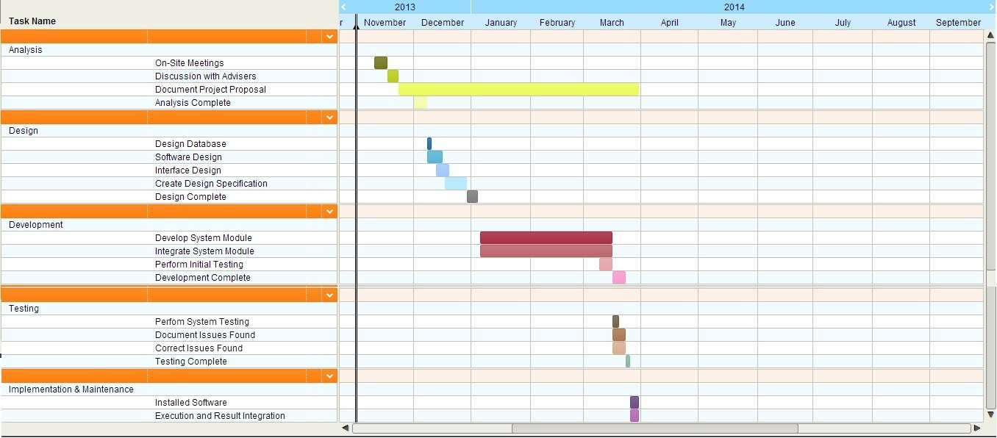
8. Timeline from November onwards

Slide 10
Thank you for the people who support us to make this presentation possible.

